Slide 1

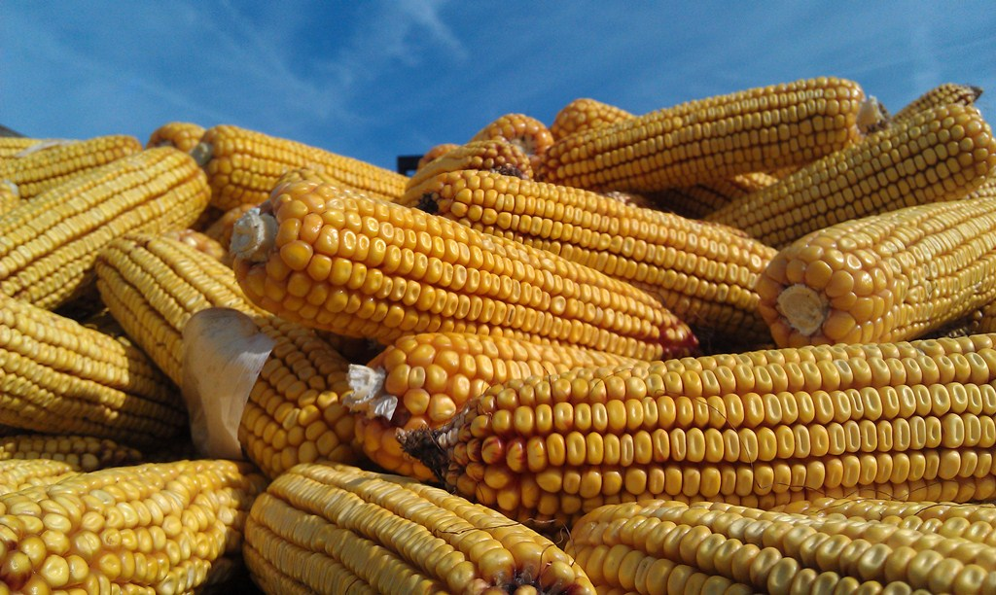
2013 Corn Yield Contest!!
2025 Corn Yield Contest

Slide 2
2025 NY Average Corn Yields
Acres harvested for grain 450K acres
down 105K from 2024
140 bushels per acre, down 29 bu. from 2024
Silage acreage harvested was 500K acres
up 45K from last year
17T per acre average, down 2T from 2024

Slide 3
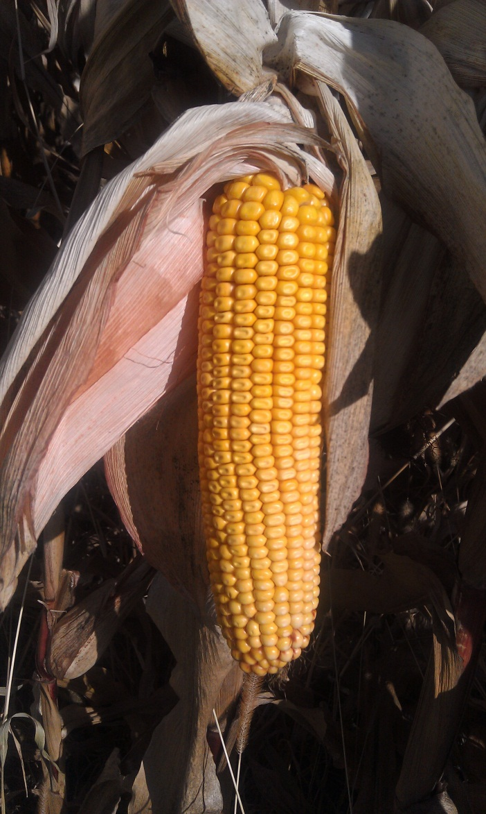
Corn Across the US
National Average = 186.5 bu * 7.2 bu
Illinois: 214 bu 3
Iowa: 210 bu 1
Indiana : 204 bu* 6
Minnesota : 201 bu* 27
Wisconsin : 188 bu* 14
Ohio : 185 bu 8
Michigan: 178 bu 2
Pennsylvania: 151 bu 13
* Record Harvest

Slide 4
2025 Corn Contest
36 corn grain entries, 15 harvested
5 regions
West, Finger Lakes, Central, North and East
13 counties
Genesee, Livingston, Orleans, Wyoming
Erie, Cayuga, Seneca, Wayne
Madison, Oneida
Clinton, Jefferson
Montgomery

Slide 5
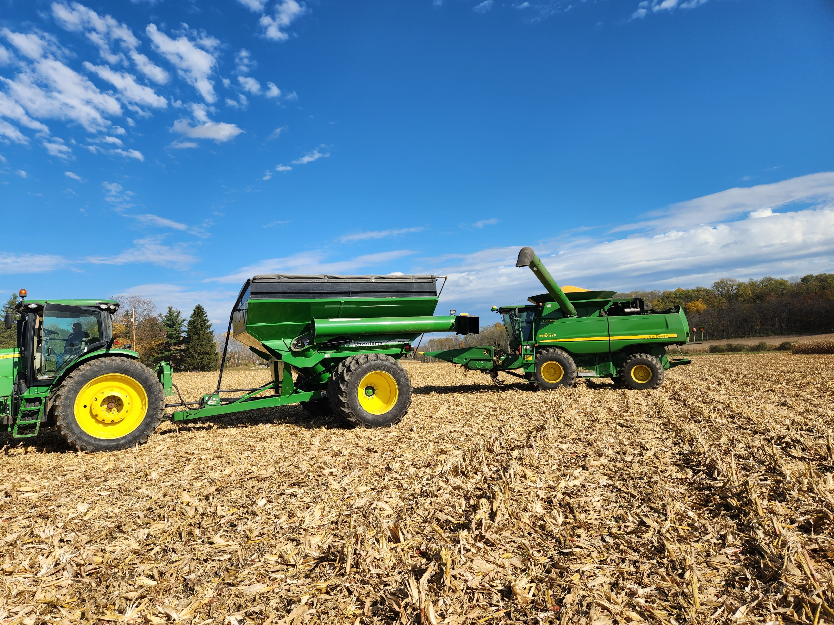
2025 Regional Winners!!!

Slide 6
Corn Contest Winners West Region
Swede Farms Livingston 311.25
2. Triple H Farms Livingston 297.67
3. Andy McIlroy Wyoming 257.17

Slide 7
Corn Contest Winners Finger Lakes Region
1. Reed Farms Wayne 284.83
2. Austic Farms Seneca 264.80
3. *

Slide 8
Corn Contest Winners Central Region
1. Bernie Townsend Jr Madison 234.82
2. Jeremy Teel Oneida 227.18
3. Zane Keith Madison 217.61

Slide 9
Corn Contest Winners Northern Region
1. Lance Rovers Clinton 258.38
2. *
3. *

Slide 10
Corn Contest Winners Eastern Region
No Final Entries

Slide 11

NY State Corn Finalists
1st Swede Farms Livingston 311.25
2nd Triple H Farms Livingston 297.67
3rd Reed Farms Wayne 284.83

Slide 12
NY State Corn Top Ten
1 | Swede Farms | Livingston | 311.25
2 | Triple H Farms | Livingston | 297.67
3 | Reed Farms | Wayne | 284.83
4 | Swede Farms | Wyoming | 268.25
5 | Austic Farm Partners | Seneca | 264.80
6 | Lance Rovers | Clinton | 258.38
7 | Andy McIlroy | Wyoming | 257.17
8 | Dan Pettit | Orleans | 241.46
9 | Bernie Townsend Jr | Madison | 234.82
10 | Austic Farm Partners | Seneca | 229.08

Slide 13

National Winners
Top Irrigated & Non-Irrigated
Strip, Min, Mulch Ridge-Till Irrigated
David Hula Charles City, VA 572.25
Conventional Non-Irrigated
Kevin Kalb Dubois, IN 425.77

Slide 14
NEW YORK WINNERS
Conventional
Non-Irrigated
1. Henry Everman Dansville 293.25
2. Lance Rovers Chazy 256.55
3. Richard Barnard York 231.62

Slide 15
NEW YORK WINNERS
Strip, Min, Mulch, Ridge-Till
Non-Irrigated
1. Matthew Swede Piffard 311.25
2. Ryan Swede Pavilion 309.08
3. Matt Kludt Kendall 307.87

Slide 16
NEW YORK WINNERS
No-Till
Non-Irrigated
1. Quin Schulerud Copake 263.24
2. Lance Rovers Chazy 242.35
3. Bernie Townsend Canastota 225.68

Slide 17
NEW YORK WINNERS
Strip, Min, Mulch, Ridge-Till
Irrigated
1. Logan Beck Palatine Bridge 257.33

Slide 18
NEW YORK WINNERS
Conventional
Irrigated
1. Paul Campbell Nichols 294.74

Slide 19
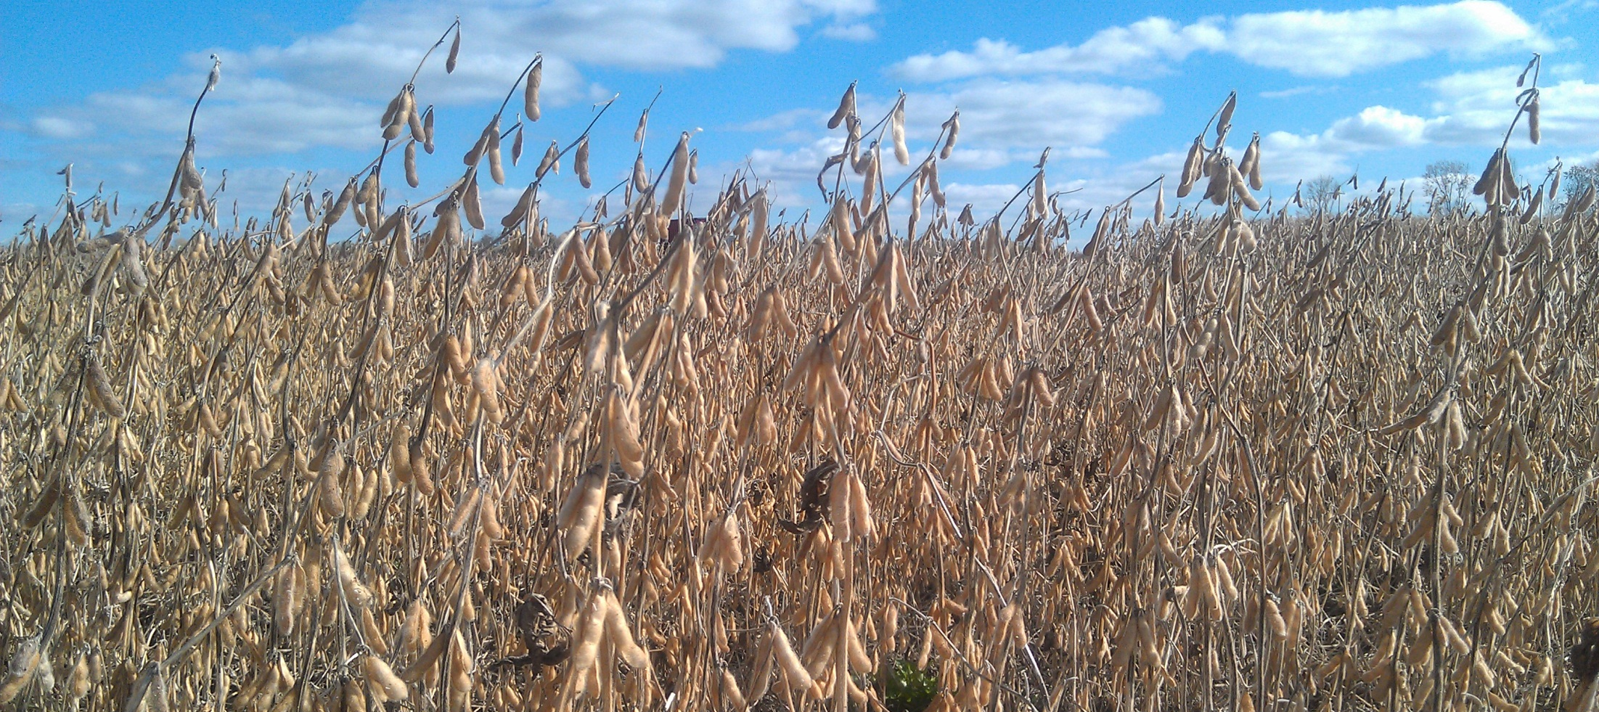
NY Soybean Yield Contest

Slide 20
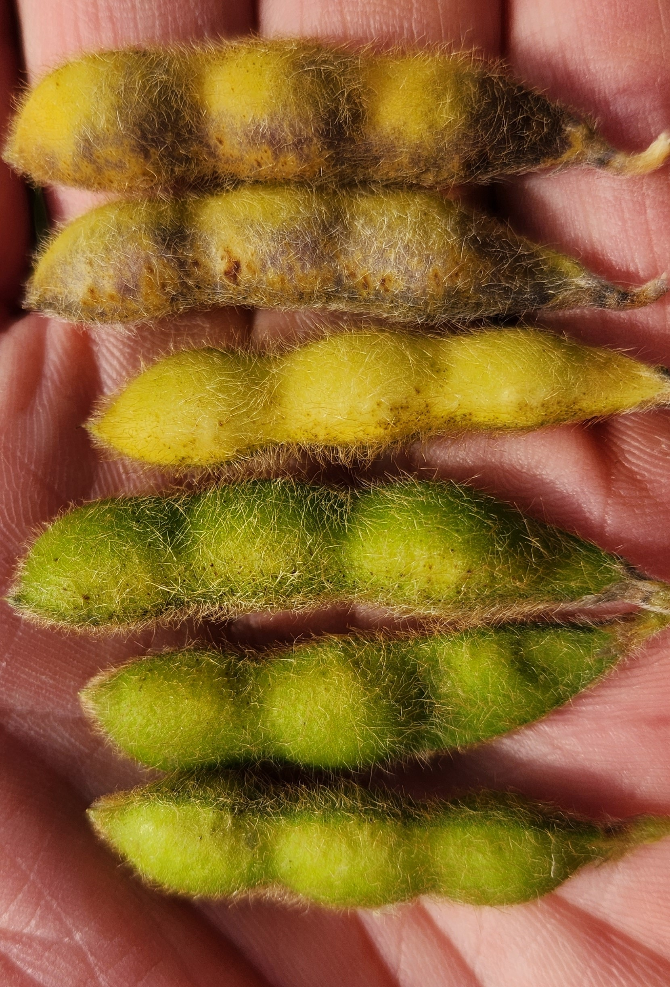
2025 New York Soybean Production
295K acres harvested, down 70K from 2024
40 bushels per acre, down 11 bushels

Slide 21
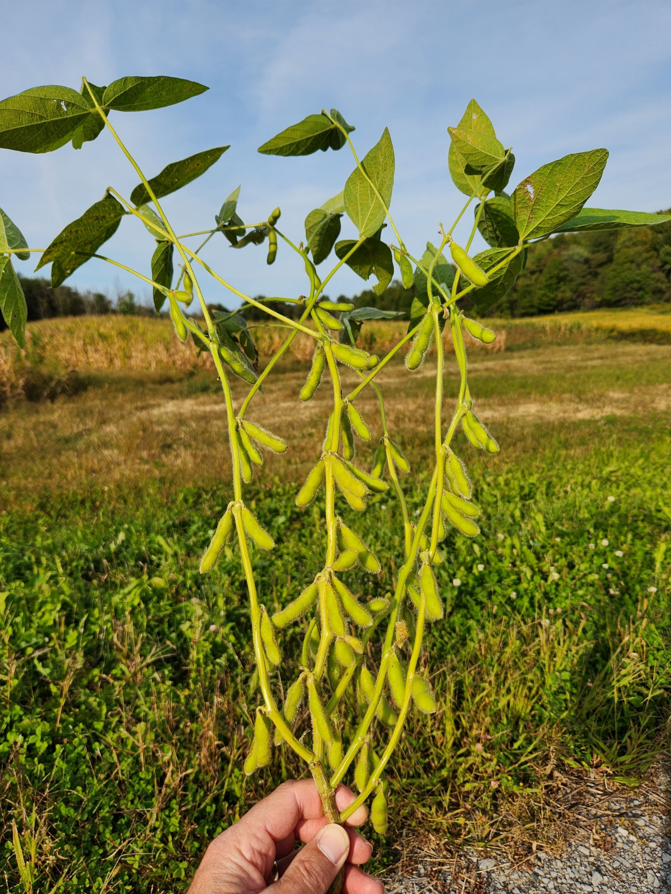
Soybeans Across the US
National average = 53 bushels* 2.3 bu
Iowa: 63.5 bu* 3.5
Illinois : 62.5 bu 1.5
Indiana: 59.5 bu 0.5
Wisconsin : 56 bu 8
Ohio: 53 bu 3
Minnesota : 52.5 bu 7.5
Michigan: 48.5 bu 0.5
Pennsylvania : 44 bu 1
* Record Harvest

Slide 22
2025 Soybean Contest
50 entries, 22 harvested
5 regions
West, Finger Lakes, Central, North & East
19 counties
Allegany, Erie, Livingston, Monroe, Orleans
Cayuga, Cortland, Seneca, Wayne, Yates
Herkimer, Madison, Oneida, Onondaga
Clinton, Jefferson
Montgomery, Rensselaer, Schoharie

Slide 23
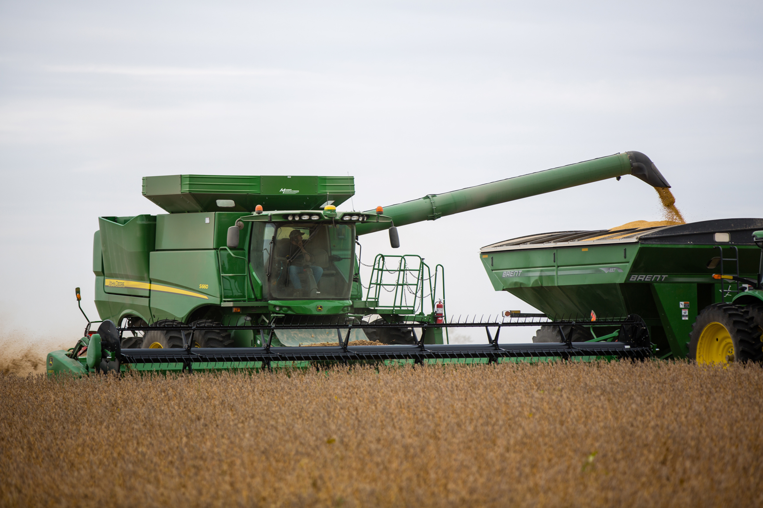
2025 Regional Winners!!!

Slide 24
NY Soybean Contest Winners West Region
Group 1
1. Tom Greenwell Monroe 82.86
2. *
3. *

Slide 25
NY Soybean Contest Winners West Region
Group 2
1. Triple H Farms Livingston 84.59
2. John Morgan Livingston 81.38
3. Swede Farms Wyoming 76.61

Slide 26
NY Soybean Contest Winners Finger Lakes Region
Group 1
1. Pit Farms Wayne 86.53
2. Reed Farms Wayne 74.37
3. Matt Henderson Yates 65.97

Slide 27
NY Soybean Contest Winners Finger Lakes Region
Group 2
1. Pit Farms Wayne 85.70
2. *
3. *

Slide 28
NY Soybean Contest Winners Central Region
Group 1
1. Mike Vecchio Oneida 73.55
2. *
3. *

Slide 29
NY Soybean Contest Winners Central Region
Group 2
1. Dennis Underwood Cortland 77.41
2. Bob Pawlowski Oneida 71.75
3. Joe Vanlieshout Oneida 65.89

Slide 30
NY Soybean Contest Winners North Region
Group 1
1. Ryan Kurtz Jefferson 72.02
2. Dennis Forrester Jefferson 68.90
3. Brian Zumbach Jefferson 63.81

Slide 31
NY Soybean Contest Winners North Region
Group 2
1. Lance Rovers Clinton 69.31
2. *
3. *

Slide 32
NY Soybean Contest Winners East Region
Group 1
1. M Columbia 83.62
2. Infinity Custom Harvesting Montgomery 70.44
3. Scott Swartz Rensselaer 70.32

Slide 33
NY Soybean Contest Winners East Region
Group 2
1. Cyrus Conard Schoharie 61.70
2. *
3. *

Slide 34
NY State Soybean Finalists
1st Pit Farms Wayne 86.53
2nd Triple H Farms Livingston 84.59
3rd Greenwell Farms Monroe 82.86

Slide 35
NY State Soybean Top Ten
1 | Pit Farms | Wayne | 86.53
2 | Pit Farms | Wayne | 85.70
3 | Triple H Farms | Livingston | 84.59
4 | Greenwell Farms | Monroe | 82.86
5 | John Morgan | Livingston | 81.38
6 | Dennis Underwood | Cortland | 77.41
7 | Swede Farms | Wyoming | 76.61
8 | Reed Farms | Wayne | 74.37
9 | Lew Bickle | Livingston | 73.71
10 | Mike Vecchio | Oneida | 73.55

Slide 36
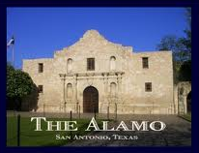
2026 Commodity Classic
San Antonio, Texas

